Slide 1
Extraction chromatography: a novel approch for metal separation
Muhammad Ramzan
Department of Chemistry, UiO
18.03.2015
Hydrometallurgy Seminar, March 2015

Slide 2
Contents
Introduction
Preparation of Extraction columns
Results
Conclusion
Hydrometallurgy Seminar, March 2015

Slide 3
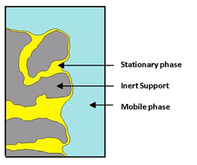
Introduction
Extraction chromatography:
Combination:
Selectivity of liquid-liquid extraction
Multistage character & rapidity of chromatographic processes
Extractant is adsorbed on the surface of an inert support
Separation of the metals is based on the distribution of the cations of interest between an organic and an aqueous phase
Include the possibility to use mineral acid as mobile phase
Amount of organic compound (ligand) required in extraction chromatography is significantly low
http://www.triskem-international.com/full_extraction_chromatographie.asp
Hydrometallurgy Seminar, March 2015

Slide 4
Introduction
General parameters of Stationary phases:
Physical stability
Selection of suitable support
Eluent parameters
Chemical stability
Composition of stationary phases change
Light, temperature & nuclear radiation
Possible unwanted redox reactions with stationary phases
TBP strongly hydrolyses in the column, when column left as such after using conc. acids
Regeneration of stationary phases
Repeatability & reproducibility
Hydrometallurgy Seminar, March 2015
Notes:
Before u are to going to use extraction chro. For metal separation the following parameters should be kept in mind.
chemically stable, inert and capable of retaining the ligands
pH and electrolyte concentration ( to avoid the loss of extractant from ST. Phases)
It was observed that tetravalent… formed strong complex with extractant
Rt times and area and cycle should be

Slide 5
Preparation of columns
Extractants dissolved in Methanol:water
(55:45)
Solution is passed through columns
Columns washed with 0.1 M HNO₃
Column is ready for separation
Metals can be separated using diluted minerls acid under gradient or isocratic elution
Separated metals detected by ICP-MS or UV/Vis after PCR
Hydrometallurgy Seminar, March 2015
Notes:
Very simple recipe to prepare modified column with various ligand density by dissolving appropriate amount of ligand in methanol : water mixture.

Slide 6
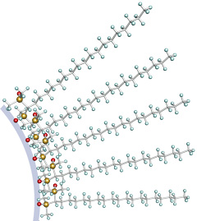
Separation Principle
Mobile phase
RE(III)
RE(III)
hydrophilic
Hydrophobic
RE(III)
hydrophilic
Hydrophobic
hydrophilic
Hydrophobic
RE(III)
hydrophilic
Hydrophobic
Silica bonded with C18
RE(III)
hydrophilic
Hydrophobic
Hydrometallurgy Seminar, March 2015
Notes:
The extractant attached with hydrophobic interaction with alkyl chain of c18 and alkyl chin of extractant. The hydrophiclic part that containt functional group id reponcible for complex formation. The metal formed complex and can be eluted with mineal acid used as mobile phase. The elution sequence depend upon the fromation of complex strength.

Slide 7
Extractants used for impregnation
H[DEHP]
H[(EH)EHP]
H[TMPeP]
Hydrometallurgy Seminar, March 2015

Slide 8
Separation of REEs
La
14M
Pr
H[TMPeP]
Ce
Tb
10M
Ho
6M
Eu
Y
Tm
Sm
Dy
Lu
Nd
Gd
Er
Yb
2M
0
0
2
Pr
4
6
8
10
12
14
16
18
20
80M
La
Ce
Y
H[(EH)EHP]
60M
Intensity (cps)
Eu
Tb
Ho
Tm
40M
Sm
Gd
Lu
20M
Nd
Dy
Er
Yb
0
0
10
20
30
40
Pr
25M
La
Tb
Ce
Ho
HDEHP
15M
Eu
Y
Tm
Nd
Sm
Dy
Er
Yb
5M
Gd
Lu
0
0
10
20
30
40
Time (min)
Chromatograms acquired with C18 (250 x 4.6 mm, 5µm, 100Å) modified columns under gradient elution with HNO₃ from 0.0 – 2.0 M in 30 min and then 2.0 M isocratic for 20 min at 60ºC. The time scale for chromatogram (c) is different from the other two
Hydrometallurgy Seminar, March 2015
Notes:
Perhaps you should show some chromatograms with all the elements

Slide 9
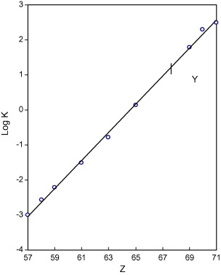
Comparsion of Log k
Log K (Log D) (obtained in LLEx with (0.75 M HDEHP in toluene and 0.5 M HCl)
Peppard et al., 1957
Log K (retention factor) obtained with
(0.74 mmol HDEHP on C18 column and 0.0-2.0M HNO₃ gradient and then 2 M Isocratic)
Hydrometallurgy Seminar, March 2015

Slide 10
Separation of commercial REOs
80M
H[(EH)EHP]
70M
60M
50M
Sm
Intensity (cps)
40M
Nd
Eu
30M
20M
Gd
Y
La
Pr
10M
Ce
Tb
Dy
Ho
0
0
5
10
15
20
25
30
35
Time (min)
Chromatograms acquired with C18 (250 x 4.6 mm, 5µm, 100Å) modified columns under gradient elution with HNO₃ from 0.0 – 0.5 M in 15 min and then 0.5 – 2.0 M in 15 min at 60ºC.
Hydrometallurgy Seminar, March 2015

Slide 11
Separation of commercial REOs
H[TMPeP]
Y
1.4M
Dy
1.2M
Tb
Ho
1.0M
0.8M
Er
0.6M
0.4M
LREEs
Yb
Intensity (cps)
Tm
Lu
0.2M
0.0
2
4
6
8
10
12
14
3.0M
H[(EH)EHP]
2.5M
2.0M
Dy
Y
1.5M
Tb
Ho
1.0M
Er
0.5M
LREEs
Tm
Yb
Lu
0.0
0
5
10
15
20
25
30
Time (min)
Chromatograms acquired with C18 (250 x 4.6 mm, 5µm, 100Å) modified columns under gradient elution with HNO₃ from 0.0 – 0.5 M in 15 min and then 0.5 – 2.0 M in 15 min at 60ºC for H[(EH)EHP. The gradient condition for H[TMPeP] 0.0 – 0.3 M in 20 min. The time scale for chromatogram obtained with H[TMPeP] is different.
Hydrometallurgy Seminar, March 2015
Notes:
REOs that contain mainly HREEO are separated on two columns. The EHEHPA column is give excellecnt separation between all REEs but took longer time to elutes but on the other hand HTEHP took shorter time.

Slide 12
Determination of actinides
Various analytical methods are used to detect very low concentration of actinides
Neutron activation, alpha spectrometry, thermal ionization mass spectrometry and fission track analysis
ICP-MS is useful for actinide determination.
Methods requires that actinide analytes be separated prior to analysis to resolve analytes with similar mass.
Analysis of plutonium (239Pu) in presence of Uranium (238UH).
Chemical separation methods are time consuming processes
Dominic S. Peterson et al., Journal of Chromatographic Science, Vol. 47, August 2009
Hydrometallurgy Seminar, March 2015
Notes:
Require large amount of sample and pre-treatment of sample. Time consuming process.

Slide 13
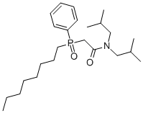
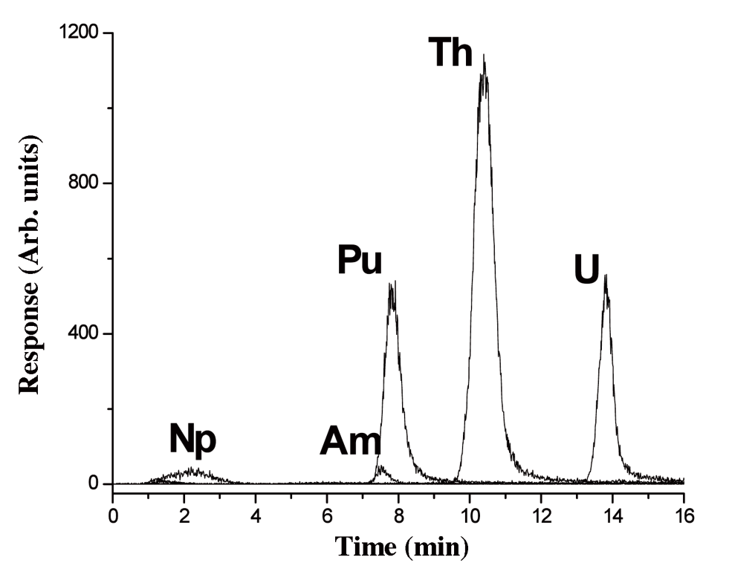
Separation of actinides
Octyl(phenyl)-N,N-diisobutylcarbamoylmethylphosphine oxide
Separation of actinide analytes on 100-cm long column, 750 μm i.d. packed with TRU resin. The sample contained 50 ppt of each actinide except thorium, which contained 300 ppt; 400 μL injected. Using gradient elution with oxalic acid.
Hydrometallurgy Seminar, March 2015

Slide 14
Advantages of impregnated columns
Commercial columns can be used to design a stationary phase of suitable selectivity for a particular group of elements
Impregnation process is easily performed & amount of extractant loading can be varied to optimize the separation efficiency
Columns may also be re-impregnated with different extractant by easily removing the previously impregnated extractant
Mobile phase could be kept simple (diluted mineral acid)
Impregnation seems to improve the stability of the column towards mineral acid used as eluent
To select suitable extractants, the long-time experience and knowledge from liquid-liquid extraction (LLEx) can be utilized
Hydrometallurgy Seminar, March 2015

Slide 15
Conclusions
Extraction chromatography provides a simple and effective method for the analytical and preparative-scale separation of a variety of metal ions
Advances in support design,most notably the introduction of functionalized supports to enhance metal ion retention, promise to yield further improvements
Impregnation of reversed-phase columns provides large flexibility to design columns for separation of a certain metals
Loading amount of extractant on the stationary phase can be increased or decreased for particular group of elements separation
Hydrometallurgy Seminar, March 2015

Slide 16
Thanks for listening
Hydrometallurgy Seminar, March 2015

