Slide 1
Mercury Extraction
Hans Vigeland Lerum
Hydromet Project Meeting
Oslo, 18th March 2015

Slide 2
Outline
Motivation
Complexation of mercury
Ligands in the solution
Extractants
Stripping
Mercury halides
Neutron activation

Slide 3
Motivation
Mercury is a highly toxic element and will often need to be removed from waste streams, etc.
Industrial solutions are nearly always composed of many components, with several possible ligands.
Most literature data is for single-ligand synthetic solutions. We want to expand on this by studying two ligand systems.

Slide 4
Extraction system demands
We do not want to extract the chief component of the solution. We want to extract pollutants in the feed.
Must be selective enough to not extract the main metal ion
Must be strippable
Must not be to environmentally hazardous

Slide 5
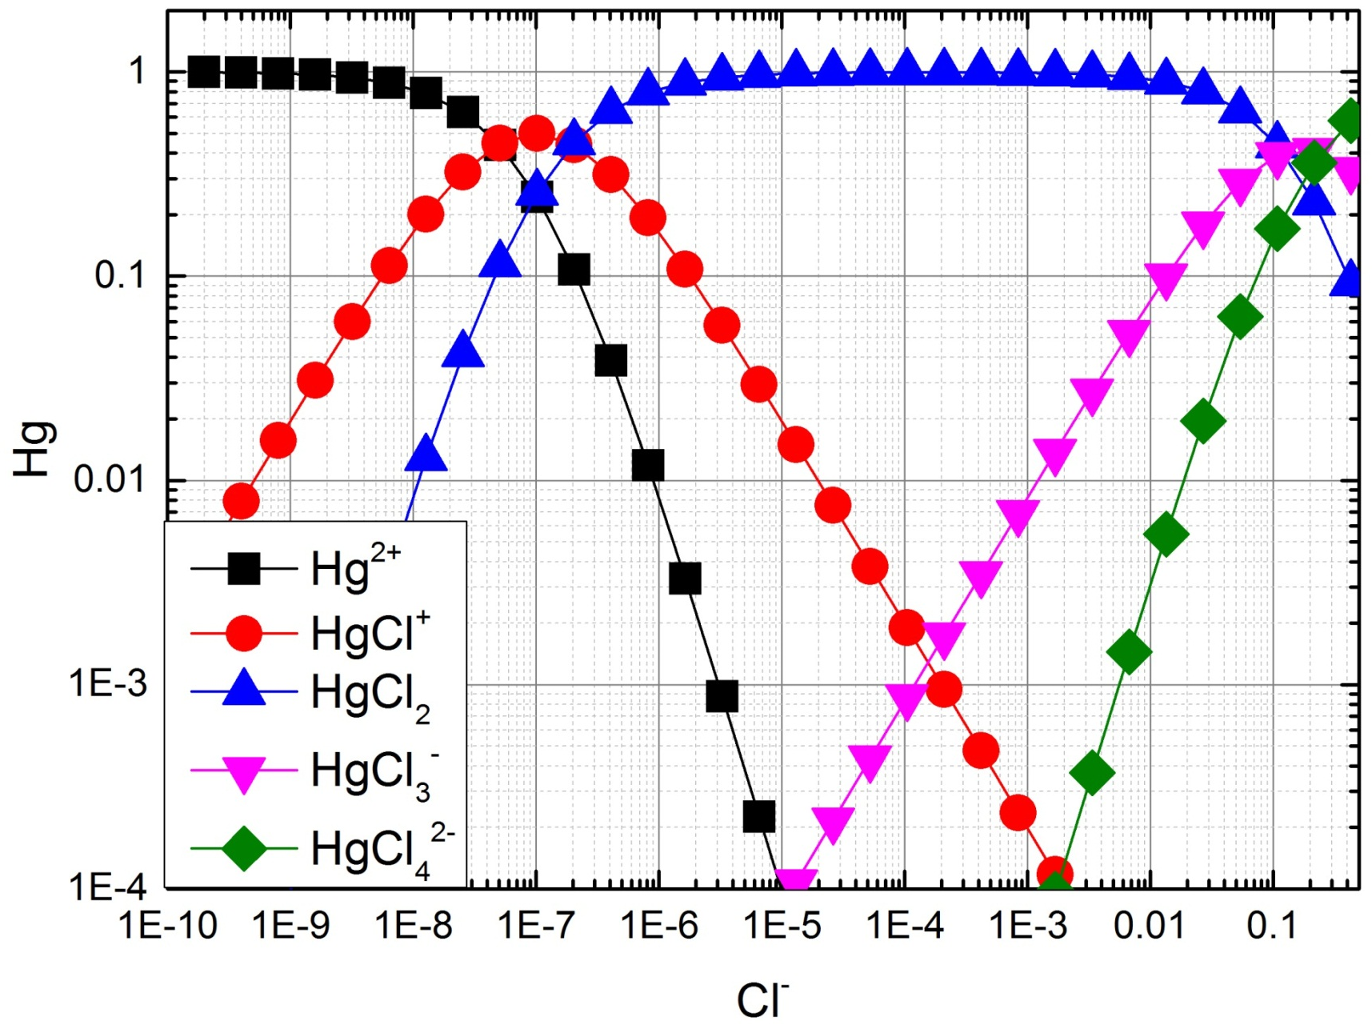
Complexation of Hg in Cl-solutions
K. J. Powell et Al. Chemical speciation of environmentally significant heavy metals with inorganic ligands. Part 1: The Hg²⁺-Cl⁻,OH⁻,CO₃²⁻,SO₄²⁻, and PO₄³⁻ Aqueous Systems. Pure and applied chemistry 77 (2005) 739-800.

Slide 6
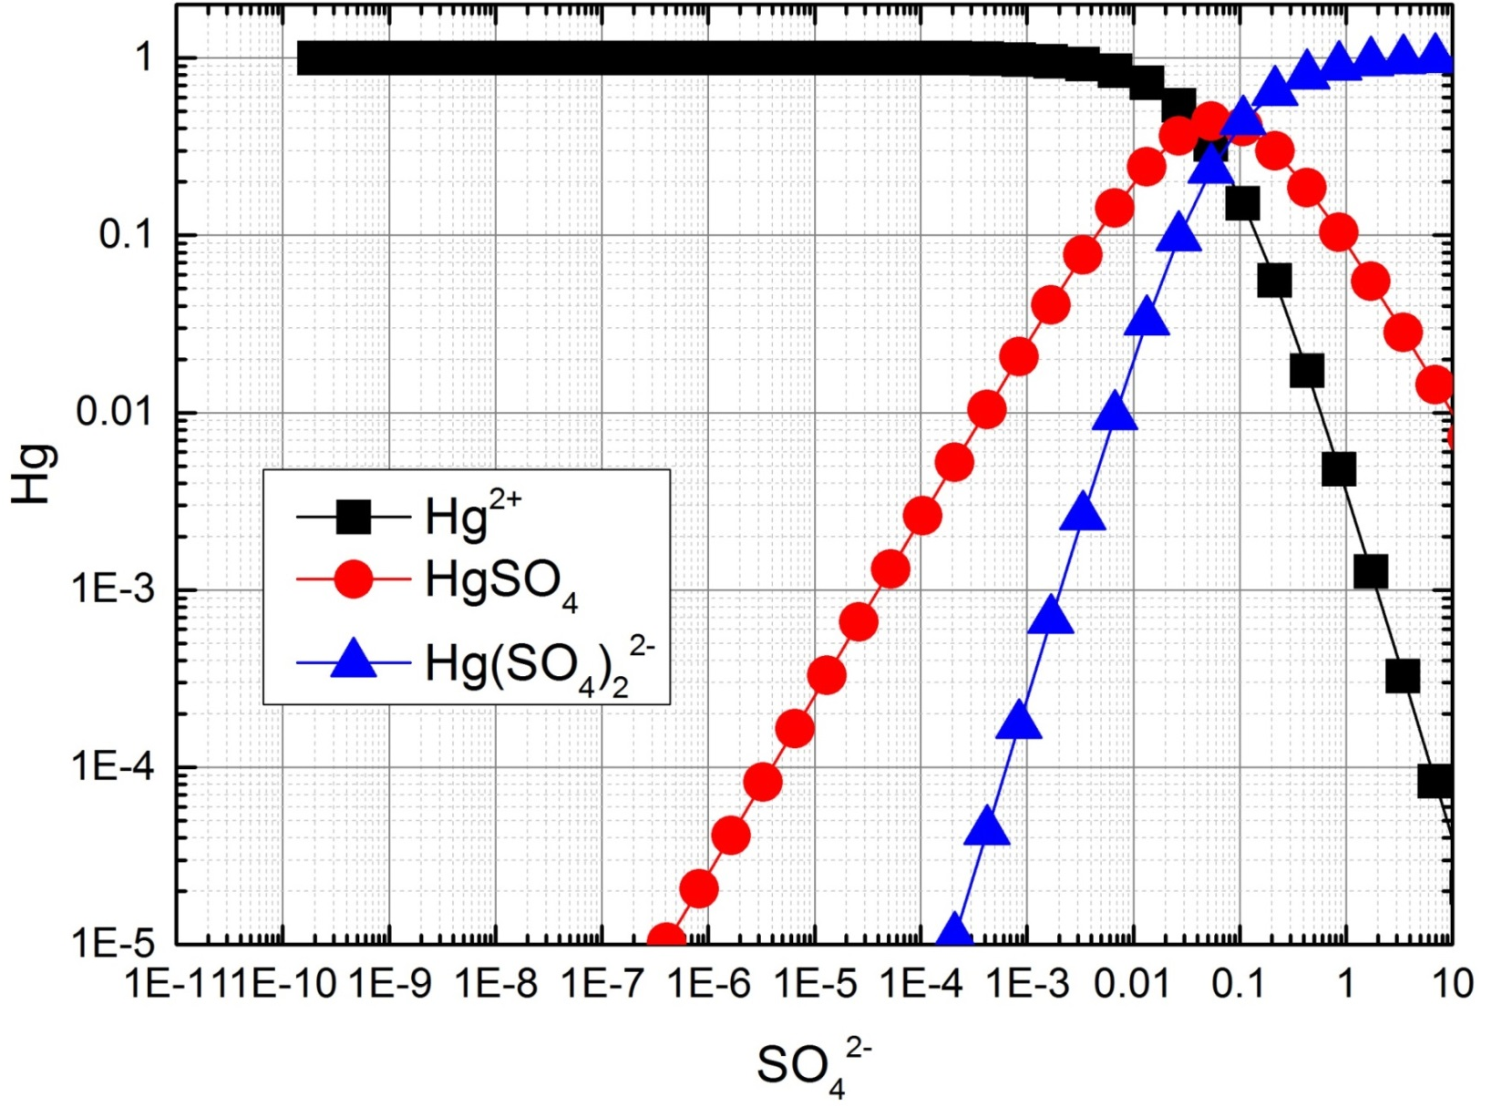
Complexation of Hg in sulphate-solution
K. J. Powell et Al. Chemical speciation of environmentally significant heavy metals with inorganic ligands. Part 1: The Hg²⁺-Cl⁻,OH⁻,CO₃²⁻,SO₄²⁻, and PO₄³⁻ Aqueous Systems. Pure and applied chemistry 77 (2005) 739-800.

Slide 7
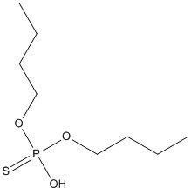
Extraction using Di-n-butyl Phosphorthioic Acid
Should not extract Ni or Zn
Extracts Hg²⁺, Bi³⁺,As³⁺,Se⁴⁺
T. H. Handley. Di-n-butyl Phosphorothioic Acid as an extractant for Metal ions. Analytical Chemistry 35 (1963) 991-995

Slide 8
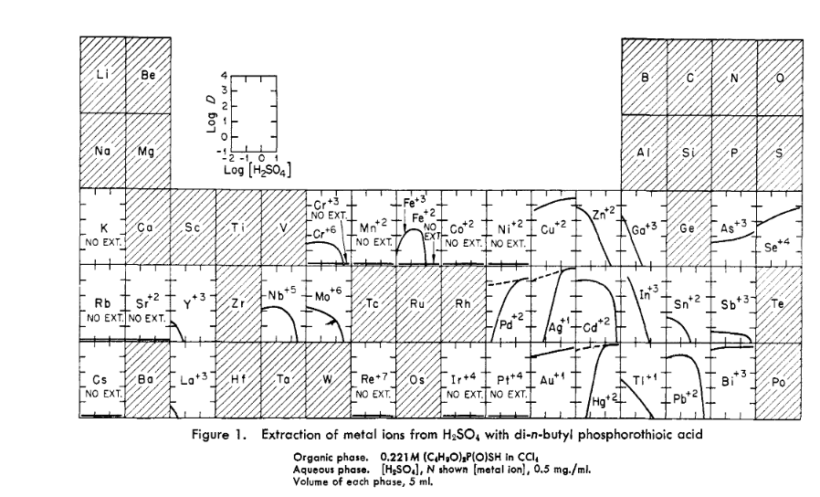
Extraction of different elements in Sulphuric Acid
T. H. Handley. Di-n-butyl Phosphorothioic Acid as an extractant for Metal ions. Analytical Chemistry 35 (1963) 991-995

Slide 9
Extraction of different elements in Sulphuric Acid
T. H. Handley. Di-n-butyl Phosphorothioic Acid as an extractant for Metal ions. Analytical Chemistry 35 (1963) 991-995

Slide 10
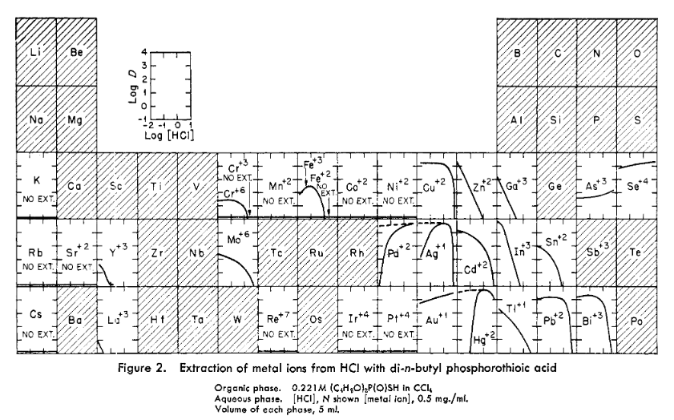
Extraction of different elements in Hydrochloric acid
T. H. Handley. Di-n-butyl Phosphorothioic Acid as an extractant for Metal ions. Analytical Chemistry 35 (1963) 991-995

Slide 11
Extraction of different elements in Hydrochloric acid
T. H. Handley. Di-n-butyl Phosphorothioic Acid as an extractant for Metal ions. Analytical Chemistry 35 (1963) 991-995

Slide 12
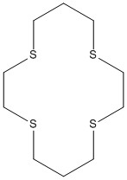
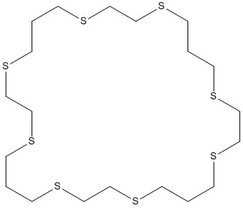
1,4,8,11-tetrathiayclotetradecane
Extracts neutral mercury chloride complexes. Does this with more or less the same mechanic as its sister compound: 1,4,8,11,15,18,25-octathiacyclooctacosan.
Is a solvating extractant.
Solvent used was nitrobenzene
D. Sevdic and H. Meider, Macrocyclic Polythiaether as solvent extraction reagents-II Mercury(II) Extraction and complex formation. Journal of inorganic nuclear chemistry 39, (1997) 1409-1413.

Slide 13
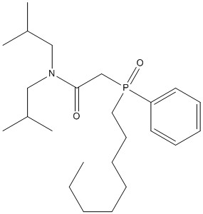
Octyl(phenyl)-N,N-diisobutyl carbamoylmethyl phosphine (CMPO)
Need from 1.9 to 2.2 moles of CMPO to extract one mole of mercury chloride.
Literature suggest that when chloride concentration is over 0.1 the primary species is HgCl₄²⁻.
Solvent used was 1.4-diisopropyl benzene.
K. J. Powell et Al. Chemical speciation of environmentally significant heavy metals with inorganic ligands. Part 1: The Hg²⁺-Cl⁻,OH⁻,CO₃²⁻,SO₄²⁻, and PO₄³⁻ Aqueous Systems. Pure and applied chemistry 77 (2005) 739-800.
K. N. Brewer et Al. Mercury extraction by the TRUEX process solvent: III extractable species and stoichiometry. Solvent extraction and ion exchange 16 (1997) 487-504.

Slide 14
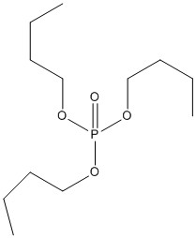
Tributylphosphate
TBP needs to be 1.5 to 1.8 moles for each mole of HgCl₂.
TBP was diluted in n-dodecane.
K. N. Brewer et Al. Mercury extractio by the TRUEX proces solvent: III extractable species and stoichiometry. Solvent extraction and ion exchange 16 (1997) 487-504

Slide 15
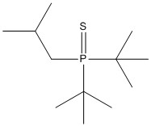
Cyanex 471X
The extraction with this compound seems to be very dependent on what kind of solvent is used. This was tested in 1 M HCl with 0.2 M Cyanex 471X
Solvent | Dielectric Constant | D
Complexing solvent
Methylisobutyl ketone | 13.11 | 82
Halogenated compounds
Chloroform | 4.9 | 9
Aromatic solvents
Benzene | 2.28 | 27
Xylene | 2.26 | 6
Toluene | 2.24 | 12
Hydrocarbons
Cyclohexane | 2.02 | 0.1
T. Francis, T. P. Rao and M. L. P. Reddy. Cyanex 471x as extractant for the recovery of Hg(II) from industrial wastes. Hydrometallurgy 57(2000) 263-268.

Slide 16
Stripping from Cyanex 471X
Stripping of Cyanex 471X from xylene using different stripping agents phase ratio was kept 1/1.
Stripping agent | %recovery
0.01 M Na₂S₂O₃ | 99
0.01 M NH₄Cl (pH=10.8) | 99
0.01 NaCl (pH=12.3) | 99
T. Francis, T. P. Rao and M. L. P. Reddy. Cyanex 471x as extractant for the recovery of Hg(II) from industrial wastes. Hydrometallurgy 57(2000) 263-268.

Slide 17
Cyanex 923
A mixture of four trialkylphosphine oxides.
Have a D ratio of around 25 when the chloride concentration is around 0.04 M.
Solvent | Dielectric Constant | D
Complexing solvent
Methylisobutyl ketone | 13.11 | 543
Halogenated solvents
Chloroform | 4.9 | 0.01
Carbon tetrachloride | 2.21 | 0.4
Aromatic solvents
Benzene | 2.28 | 2
Xylene | 2.26 | 3
Toluene | 2.24 | 2
Hydrocarbons
Cyclohexane | 2.02 | 94
Kerosene | 2 | 426
R. Meera, T. Francis and M. L. P. Reddy. Studies on the liquid-liquid extraction of mercury(II) from acidic chloride solutions using Cyanex 923.
Hydrometallurgy 61 (2001) 97-103.

Slide 18
Stripping from Cyanex 923
Stripping agent | %recovery
0.01 M Na₂S₂O₃ | 99
0.01 M NH₄Cl (pH=9) | 95
0.01 NaCl (pH=9) | 0.3
5% thiourea in 1% HCl | 99
2 M HCl | 2
Stripping Cyanex 923 using different agents.
Stripping from kerosene
R. Meera, T. Francis and M. L. P. Reddy. Studies on the liquid-liquid extraction of mercury(II) from acidic chloride solutions using Cyanex 923.
Hydrometallurgy 61 (2001) 97-103.

Slide 19
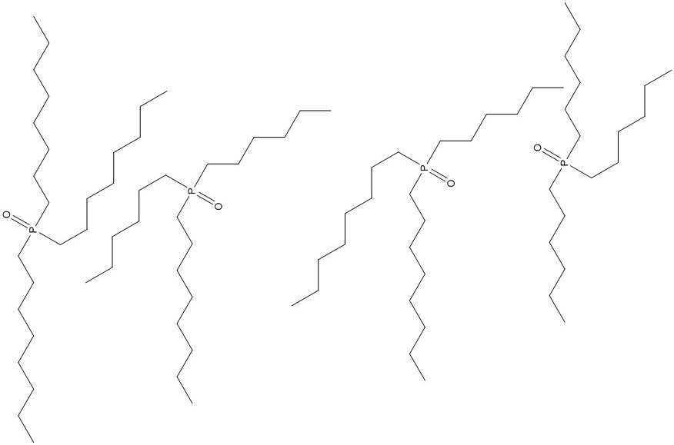
Constituents of CYANEX 923 components

Slide 20
$${HgX}_{2}$$
When X is an halogen. It is unpolar and huge.
This means that it can be more soluble in organic solutions than aqueous solutions.
The bigger the halogens the less soluble in water than it is in organic solvents
T. Sekine and T. Ishi. Studies of the Liquid-Liquid partition systems. VII. The solvent extraction of Mercury (II) Chloride, bromide, iodide and thiocyanate with some organic solvents. Bulleting of the chemical society of japan 43 (1970) 2422-2429

Slide 21
Neutron Activation Analysis
Mercury is attractive for neutron activation analysis.
It has a high cross section, ¹⁹⁶Hg has a cross-section of 3000 barn, for thermal neutrons.
Using UiO’s current neutron source we will only have an activity of 1.1 kBq/gram. This is to low.
A new stronger neutron source could make this a more viable technique.
J. Magill G. Pfenning and J. Galy. Karlsruher Nuklidekarte 7 (2006)

Slide 22
Direct mercury analyzer
Working range 0.0015 ng-1200 ng.
Can handle solid, gas and liquid samples.

Slide 23
Extraction conclusions
The most promising extractant seems to be Di-n-butyl Phosphorthioic Acid
Only have data in CCl₄
Needs to be tested in more suitable solvents
For Cyanex 471x, 923, methyl isobutyl ketone was promising
What is the most suited?

Slide 24
Analysis conclusions
Direct mercury analyzer is probably the best option
IFE does not activate mercury
Radioactive mercury must be bought elsewere
The neutron source at UIO is too weak
A neutron generator could open up new possibilities

Slide 25
Alamine 304
An impure trilauryl amine, a high weight tertiary amine. I assume that this extractant change the composition of the solution. The extraction is low until the concentration is above 1 % then it increases drastically. Organic solution is kerosene aqueous solution prior to extraction is 0.1 M HCl. Here the extraction increases with increased HCl concentration.
Alamine concentration % | Mercury extracted
0.2 | 6
0.5 | 7
1 | 66
2 | 88
50 | 99
C. McDonald and G. H. Pahlavan. Solvent extraction of mercury using alamine 304. Microchimica Acta, 2 (1982) 77-82.

Slide 26
Stripping from 5% Alamine 304
Stripping agent | Mercury extracted %
NH₄OH 2.5 M | 38
Na₂S 1 M | 39
Na₂SO₃ 1 M | 56
KOCN 2.5-5 M | 64-94
KSCN 2.5-5M | 71-91
HNO₃ 1.25 - 5 M | 42-99
NaOH 0.1 - 2 M | 85-99
EDTA 0.02 – 0.05 M | 97-98
C. McDonald and G. H. Pahlavan. Solvent extraction of mercury using alamine 304. Microchimica Acta, 2 (1982) 77-82.

Slide 27
Prompt Neutron activation analysis
The ¹⁹⁹Hg isotope has an atomic abundance of 16.87% and a cross-section of thermal neutrons of 2100. However the ²⁰⁰Hg is not radioactive. But it can be used with prompt gamma. This together with the 196 isotope should give a high number of counts per second.
R. Paviotti-Corcurea. https://www-nds.iaea.org/pgaa/databases.htm . Database for Prompt Gamma-ray Neutron activation analysis
J. Magill, G. Pfenning and J. Galy. Karlsruher Nuklidekarte 7 (2006)

