Slide 1
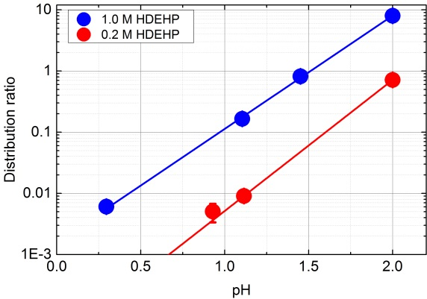
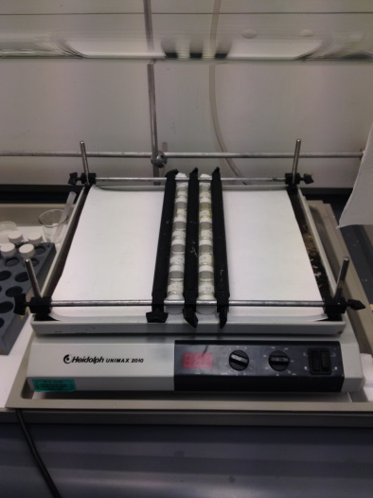
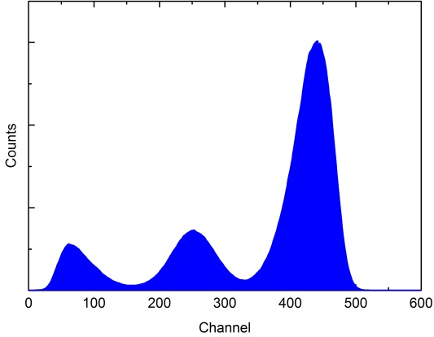
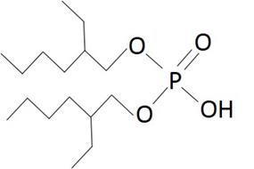
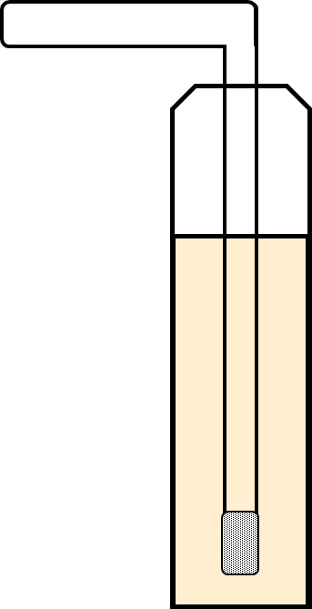
Extraction of cadmium from nitric acid
Håvard Kristiansen

Slide 2
Jon Petter Omtvedt
Dag Eriksen
Grethe Wibetoe
Tom Andersen

Slide 4
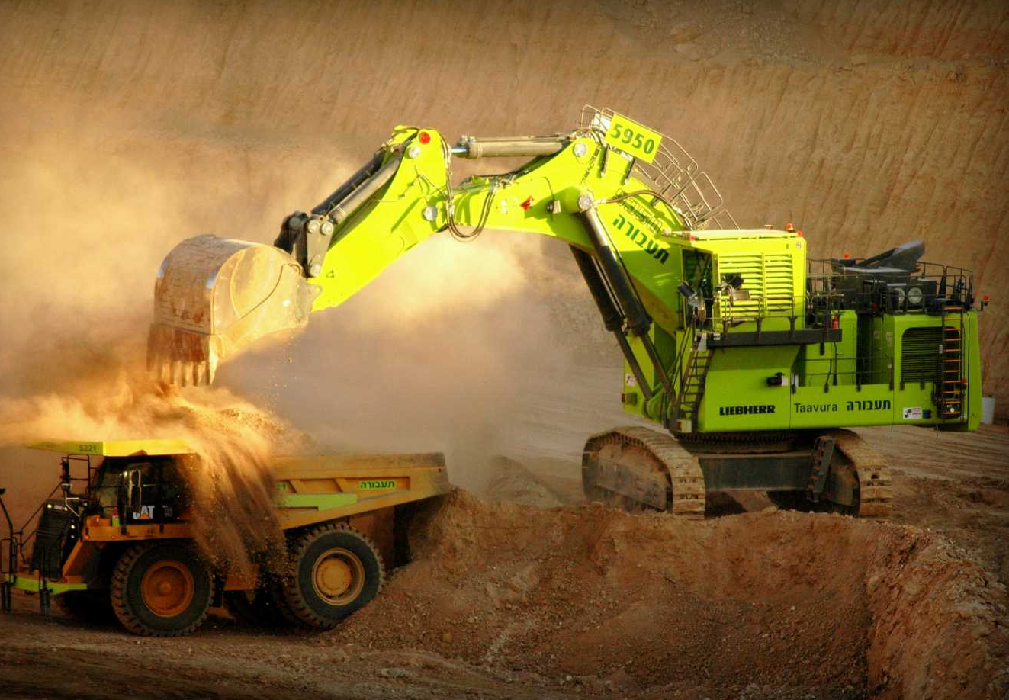
Ca₅(PO₄)₃F
Notes:
- The raw material for fertilizer is a mineral called apatite.
Apatite is a non-renewable resource and it can contain a lot of impurities, especially heavy metals such as cadmium.
So far, the fertilizer industry has been able to selectively extract clean ores of apatite. However, much of the remaining deposits have a lot of cadmium, which one must remove during the production process.

Slide 5
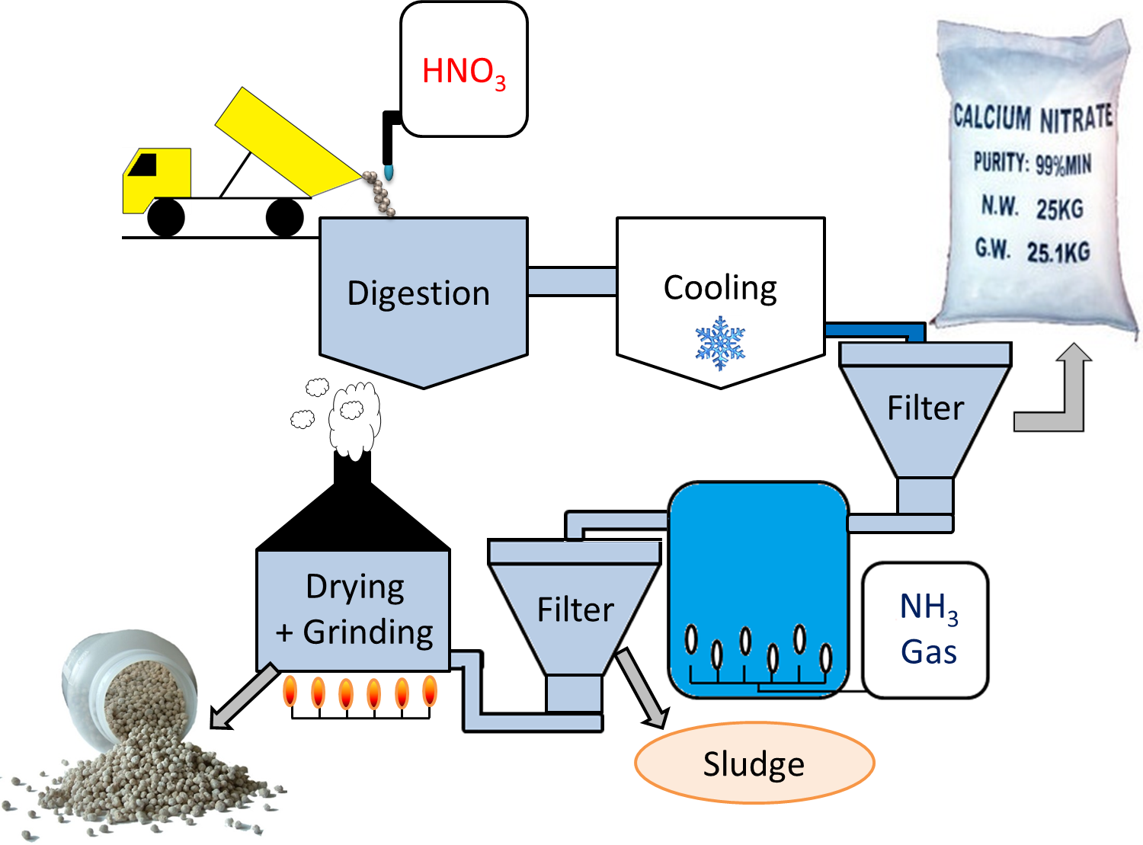
Ca₅(PO₄)₃F
Cd ?
Mother
liquor

Slide 6
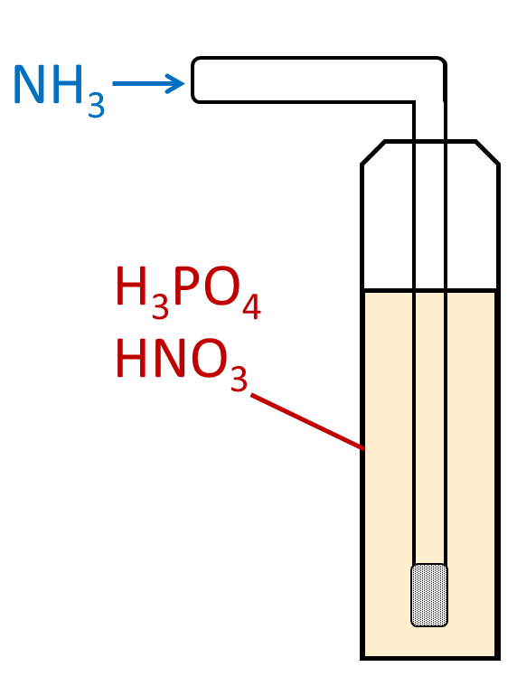
¹⁰⁹Cd
NH₄⁺
NO₃⁻
H₂PO₄⁻
c_{Cd,løsning}
Ca(H₂PO₄)₂
M(H₂PO₄)_{n}
c_{Cd,utfelling}
$$\frac{c_{Cd,solution}}{c_{Cd,precipitate}}=1±0.1$$

Slide 7
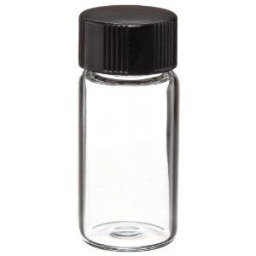
Solvent extraction
Liquid scintillation counting
¹⁰⁹Cd
1. Shaking
Org
Org
2. Centrifuging
Aq
Aq

Slide 8
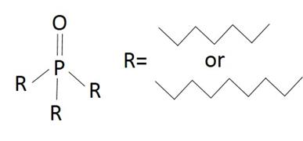
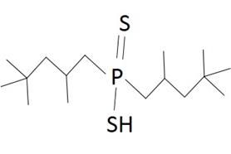
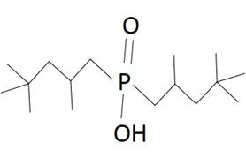
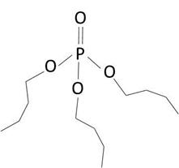
HDEHP
Cyanex 923
Very effective (>99 % extraction)
Difficult to strip
Oxidized by HNO₃
Cyanex 301
Cyanex 272
TBP

Slide 9
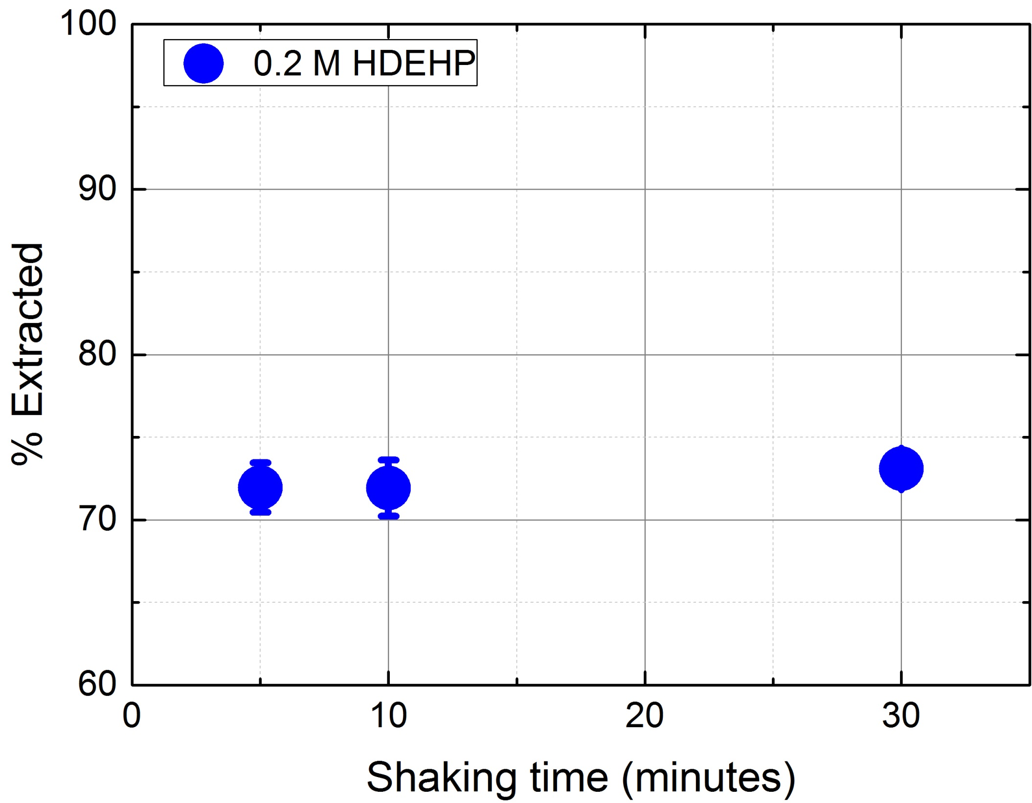

Slide 10
Slope=2
Slope=2

Slide 11
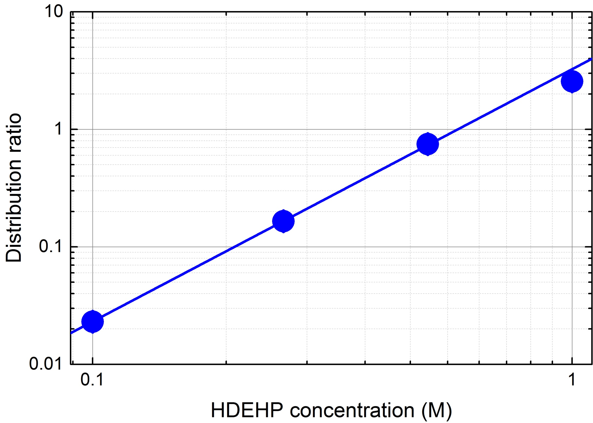
HDEHP
Slope=2
Aqueous phase:
0.04 M HNO₃ and 0.005 M H₃PO₄

Slide 12
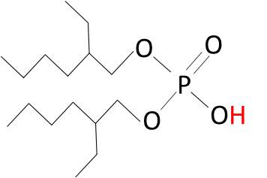
Slope=2
Slope=2
Cd²⁺ (aq) + 2HA (org) ⇌ CdA₂ (org) +2H⁺ (aq)

Slide 13
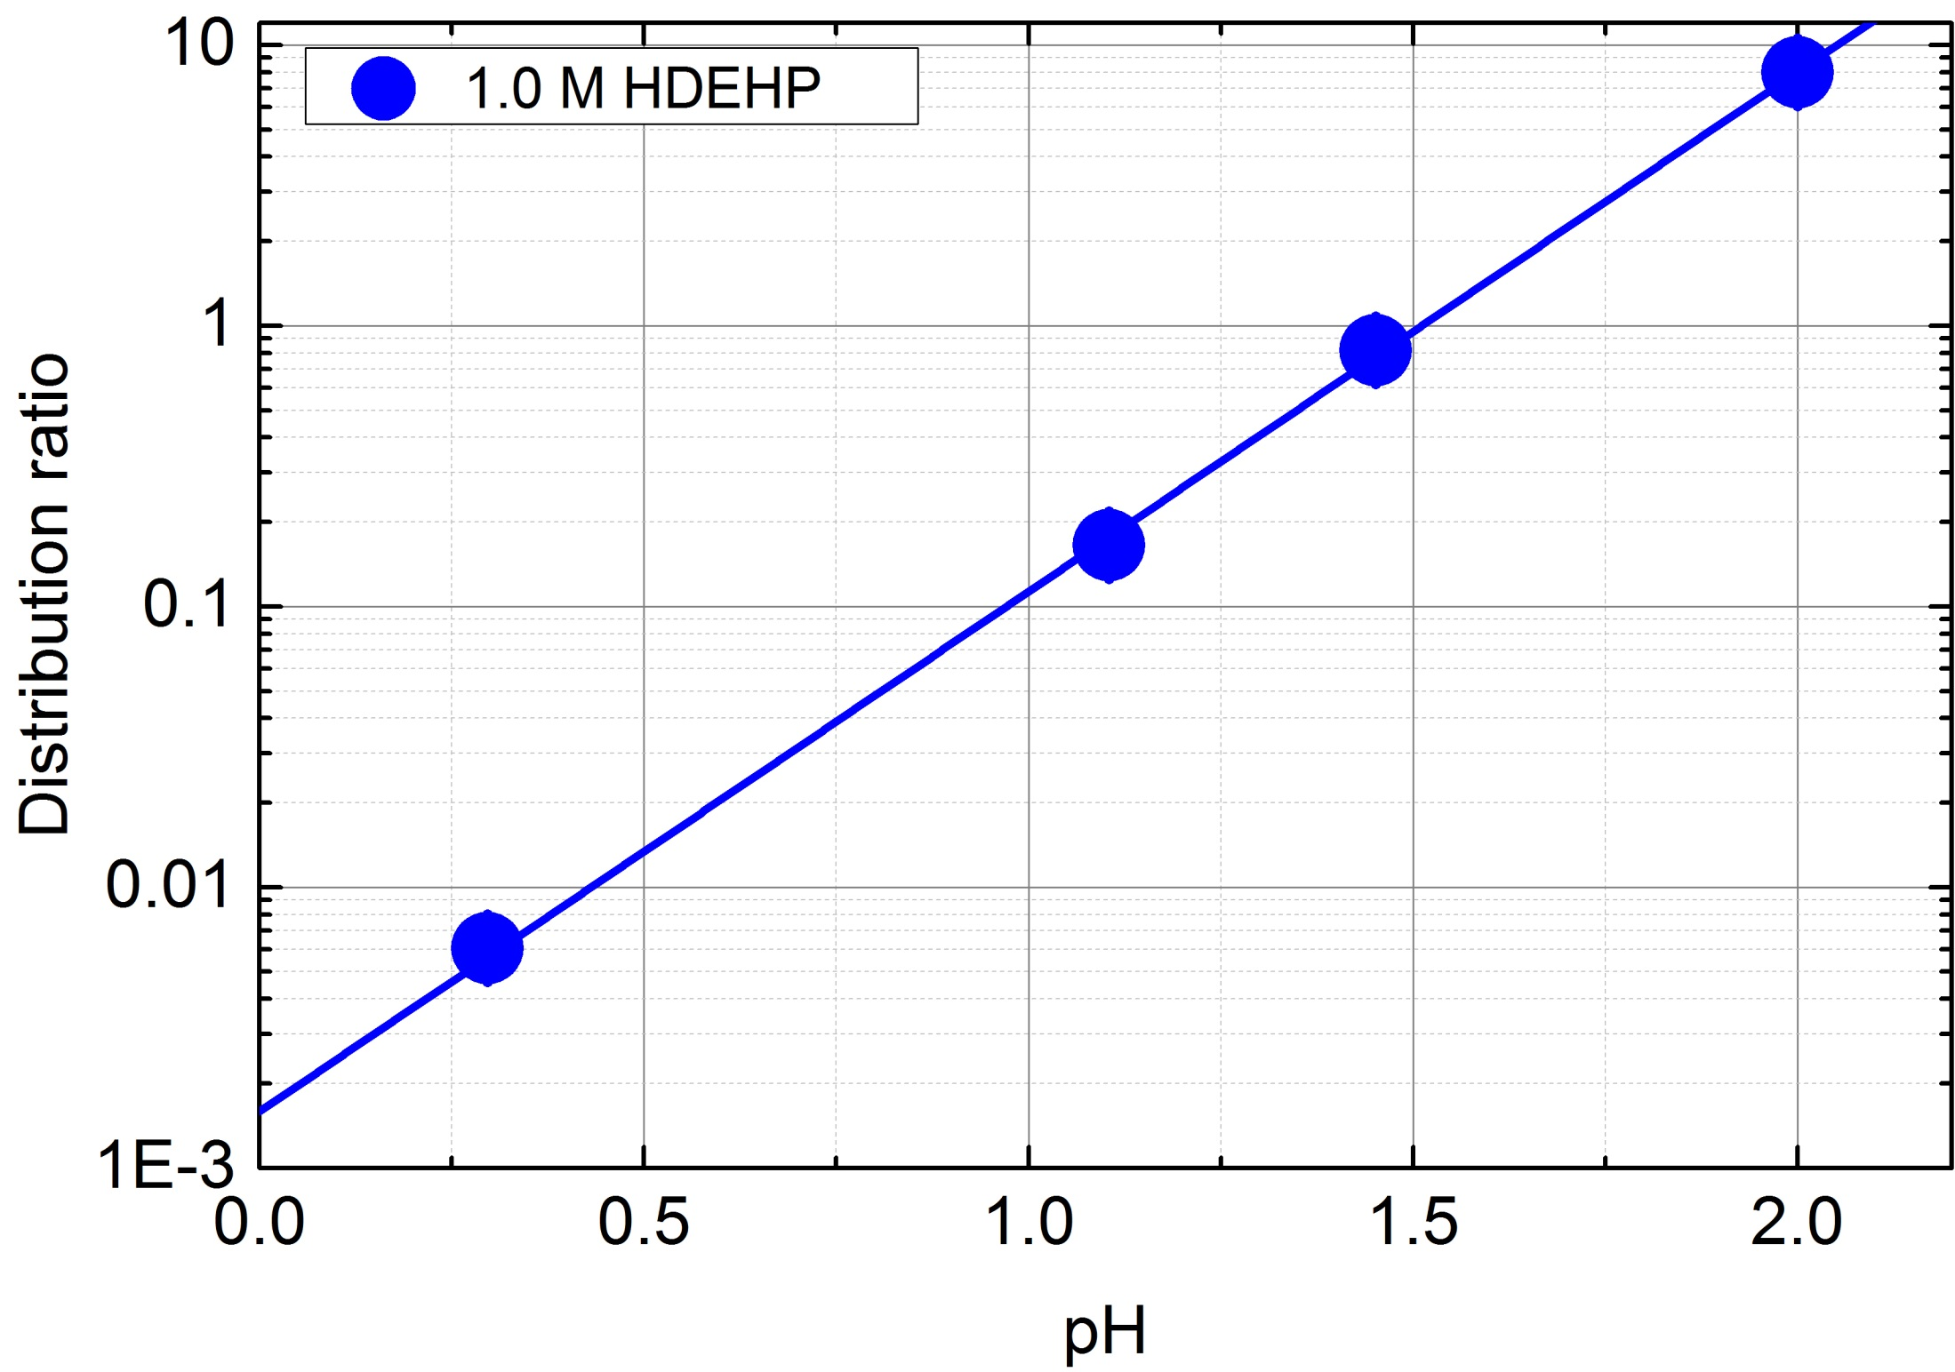
Extraction
Stripping

Slide 14
Refined
NH₄NO ₃
Loaded HDEHP
Mother liquor
Solvent extraction
Stripping
1 M
HDEHP
1 M
HNO₃
Loaded
HNO₃
Separation
(IX column)
Separated metals

Slide 15
Gjenstående spørsmål
Hvordan binder Cd seg til utfellingen som dannes under nøytralisering?

Slide 16
Gjenstående spørsmål
Kan resultatene fra ekstraksjon med syntetisk HNO₃ og H₃PO₄ reproduseres med Yara sin moderlut?
Cd²⁺ (aq) + 2HA (org) ⇌ CdA₂ (org) +2H⁺ (aq)

Slide 17
Spørsmål eller forslag?

